Slide 1
Evolution of Triton - User Experience
December 2024

Slide 2
Agenda
Affirm the TRITON vision
Confirm requirements & typical economist workflow
End-user pain points
TRITON- Fabric PoC key findings
Other considerations & next steps
Discussion

Slide 3
What
Vision
Triton vision
Self-serve platform that meaningfully accelerates and empowers users in their work (Analysis, Modeling, Research and Monitoring) with financial markets data
Triton users
Diverse clientele of about 150 users ranging for economists, researchers, traders, analysts, accountants, and senior management
Data sources
30 user-ready tables maintained and refreshed by Triton (Gov Zone)
Non-Gov’d / business led sources
  Bring-your-own data (brought by users)
  Business owned model output
Empower Users working with data
Economies of Scale & Automation
High Transparency / Searchability
Collaboration & Share-ability (w/ safety nets)
Reproducibility & Supportability

Slide 4
Journey Checkpoint
1 year live – many successes but challenges remain especially in User Experience
Major Successes:
  Our data is trusted and used by more clients than ever before
  Enablement pieces (e.g. PBI Templates, Data Search and Documentation) are well received and used regularly
  Users are developing products and novel insights fairly independently
  Remaining Challenges:
    Too many frictions remain for most users to adopt working within the cloud environment
      Missing Components, Low Flexibility, Complexity, Lack of integration between environments
    Need for greater scalability and resiliency of Triton PBI solution

Slide 5

End User Requirements of Triton 1/2
Central data
  Easily onboard own data in any common format
  Access and manipulate with Bank governed data (eg LSEG QAD & Azure Delta)
Flexible and timely updates
  Flexible scheduling and triggers of: data refresh, notebooks/code and PBI reports
  Near real-time updates possible (eg LSEG Workspace prices taken intraday)
Efficient and streamlined analytics connected to their data
  Multi-language coding and debugging is supported and efficient
  Compute is fast and reliable with their data
  Commonly used coding packages are readily available
  External tools can read data and write back to central location
Central Data |  | Integrated Visuals
Update Control |  | Process Monitoring
Analytics w/ Data |  | Process Resilience
Access Controls |  | Accelerators
Self-serve data access controls
  Users can self-manage access with AD groups
  Triton can efficiently monitor and support user activity

Slide 6
End User Requirements of Triton 2/2
Integrated visualization
  Visualisation is integrated inside of notebooks/code
  Going from data/model output to a dashboard/report is fast and easy
Flexible and scalable scheduling and monitoring of processes
  Ability to schedule and monitor data updates, pipelines, notebooks, datasets
  No code solutions to set-up event-based alerts
Resiliency of code and data
  Allowable separation of development and “operational” data/code
  Version control of code
  Scalable back-up and recovery
Availability of templates to accelerate outcomes
  Notebook
  Pipeline
  PBI report
Central Data |  | Integrated Visuals
Update Control |  | Process Monitoring
Analytics w/ Data |  | Process Resilience
Access Controls |  | Accelerators

Slide 7
Evaluation Criteria
Indicators of Successfully or Not-Successfully met is an overall gauge of whether the current capabilities meet user needs and expectations
  keeps majority of users working in the desired environment, using patterns that are in long term best interest of the Bank

Slide 8
Current Pain Points in User Experience

Slide 9
Challenges with Current Analytic Centrale
Central data
  Limited, slow and manual BYOD
  Unclear how Lake can read other sources
  Behind Private Endpoint – limits integration capability
Flexible and timely updates
  Not possible for users to schedule updates/uploads of data, lack event-based triggers
  Near real-time not automatable
  Incremental generally not feasible
Efficient and streamlined analytics connected to their data
  Individual Cluster is slow to start and disconnects after 20m
  Shared Clusters are slower than legacy tech & inconsistent
  Read from external tools is limited to ODBC (slow) and write-back not possible
Self-serve data access controls
  Schema level controls administered by third party.
  New AD groups regularly needed
Central Data |  | Integrated Visuals
Update Control |  | Process Monitoring
Analytics w/ Data |  | Process Resilience
Access Controls |  | Accelerators
Integrated visualization
  Databricks better for ad-hoc visualization, not an enterprise BI tool
Flexible and scalable scheduling and monitoring of processes
  Alert capabilities are limited and manual
Availability of templates to accelerate outcomes
  Templates pipelines and BI report not available

Slide 10
Challenges with Current Power BI
Central Data |  | Integrated Visuals
Update Control |  | Process Monitoring
Analytics w/ Data |  | Process Resilience
Access Controls |  | Accelerators
Central data
  Slow and involved process to bring data from Databricks to PBI, incremental problematic
  Need to serve data to users in 2 environments
Flexible and timely updates
  Incremental loads is not reliable
  Near real-time not optimal
  Manual intervention required to get updated data
Efficient and streamlined analytics connected to their data
  Limited data transformation capabilities
Self-serve data access controls
  Difficult to organize content in Workspace
Integrated visualization
  Code-based visualization is not enabled
Flexible and scalable scheduling and monitoring of processes
  Limited monitoring of workflows only
Resiliency of code and data
  Creation of PBI semantic model is manual
  No back-up possible except semantic model
Availability of templates to accelerate outcomes
Limited to a PBI template report

Slide 11









Current triton user workflow
User Environment 1
Analytics Centrale
User Environment 2
Dedicated PBI workspace for team
Databricks
notebooks
Tables in user catalog/db
PBI semantic model/dataset
PBI report
Team App
Databricks code-based environment to transform data and build models
Power BI space to visualize data, create and share reports
Code back-up
in GitHub
User data
(non-managed)
External
tools
R Drive
Report back-up in SharePoint
Triton Environment 1
Databricks production
Triton Environment 2
Triton dedicated PBI workspaces
Triton PBI App
Data search
Tutorial
Chatbot
Data pipelines
Databricks
notebooks
Databricks user facing tables (i.e. user Lakehouse)
PBI dataflows
PBI template report
Notes:
2 main working platforms (for both Triton and Users) –each has own purpose and purposely built
Each has solutions to allow for Safeguarding of work, Collaboration and Sharing.
Pre-built solutions to accelerate work
Access to Triton Data
+ central info hub & streamlined navigation

Slide 12
Fabric PoC – End User Experience

Slide 13
Fabric PoC Outline
Goal
Assess how and to what extent Fabric could help Triton fully meet the requirements for end user experience
How
Implement a Triton environment in Fabric that enhances the Triton Power BI environment and supports user workflows
Build an entire user workflow using Fabric that is representative of FMD’s most sophisticated users/use case.
Leverage Microsoft recommended patterns and best practices
Success metrics
Business value w.r.t. the 8 user requirements
Efficiency/resilience/scalability of Fabric components
Ease of use by users and developers

Slide 14
Fabric PoC - Set-up and team
The user strictly works 100% in Fabric Workspace (i.e. not Databricks)
The user can leverage all Fabric available tools to do its work
    Pipelines
    Notebooks
    Onelake file explorer
    Data activators
    Dev ops integration
Triton managed datasets are served to users from a Fabric Lakehouse
  External consultants
  Mohamed
  Vibha
  ITS/IDAS
  Pavel
  Frank
  Gabrielle
  FMDA
  Max
  Luke
  Mohib
  Chris
Notes:
Just a quick note about those who were involved in the PoC. We had weekly discussions as a group to discuss the goals, requirements and determine the architecture and the various fabric components that could be leveraged. Vibha and myself worked together daily to implement and test various approaches. I involved several of my colleagues in FMD to implement some of the components that will be demoed today. These are colleagues who have extensive experience in working in databricks so their feedback was crucial.

Slide 15







PoC of triton user workflow using Fabric
User Environment
Dedicated Fabric workspace for team
Notebook
OneLake file explorer
Azure dev ops
PBI report via Direct Lake
Team App
Pipeline
User Lakehouse
Shortcut
Third Party User data (non-managed)
Triton Environment 1
Databricks production
Triton Environment 2
Triton dedicated Fabric workspaces
Triton PBI App
Data search
Tutorial
Chatbot
Pipeline
Notebooks
Curated tables
Templates
Pipeline
(dataflow, copy data, notebook)
Lakehouse
Notes:
Let me emphasize three things.
These most challending thing of the PoC was for the team to design the proper Fabric architecture that will allow us meet the complex and interconnected requirements our user workflows. It was not easy at times, but in the end, the team was able to agree on robust design unlocked a lot of the various core objectives of the POC.
We wanted the presentation go beyond diagrams and really take the time to show some of the powerful features and inner workings of Fabric. Vibha and I will take the time to demo the Fabric environment and components we have implemented.
The feasibility of all components I will show is confirmed. The PoC is not final and for some sections, we want to test some enhancement that could make them more scalable or resilient.
-Let me introduce the Fabric environments that we have designed in the PoC at the high level.
-Let me start with the Triton Environments. Triton developers work in two places. The first is the current databricks environment that handles the current governed data pipelines. The second is the Fabric environment, which is just a Fabric workspace only opened to Triton developers. It actually looks identical to the current power bi workspace for Triton, except that more features are available. The environment involves data pipelines and notebooks that moves and organizes data into lakehouses, which are a similar to databases in databricks, mix of files and tables.
-For users, they have access to Fabric via a dedicated workspace set-up for their team, exactly like the current Power BI solution. Just like the Triton solution, Fabric components are enabled in that workspace.
Just like Triton, users can bring data in using pipelines, transform it using notebooks and organize their data into lakehouse. Lakehouses can easily be featured in a report and a dedicated App.
Content of the triton and user workspaces are integrated with Azure devs ops or Github enterprise. Note that Github enterprise is a forthcoming feature. The integration will not be part of the demo but it is a major improvement from Power BI, which did not have any of the integration and required a manual back of of reports inside of a sharepoint library.

Slide 16




Setting up the Fabric Triton environment
Triton Managed
Data Sources
Triton Environment
Dedicated Fabric workspace for Triton developers
Ingest
Store
Curate
Serve
Monitor
Staging Lakehouse
Notebook
Gold Lakehouse(s)
Monitoring Lakehouse
30 user-facing tables in Databricks
Dataflow Gen2
FMD
MTRS – Restricted Users
Notebook
Shortcuts
On-prem SQL database (QaD)
Pipeline
Team 1 Workspace
Team 2 Workspace
Team 3 Workspace
Team ‘N’ Workspace
User Lakehouse 1
+ BYOD
User Lakehouse 2
+ BYOD
User Lakehouse 3
+ BYOD
User Lakehouse N
+ BYOD

Slide 17
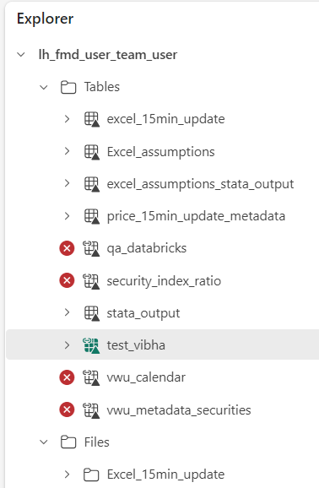
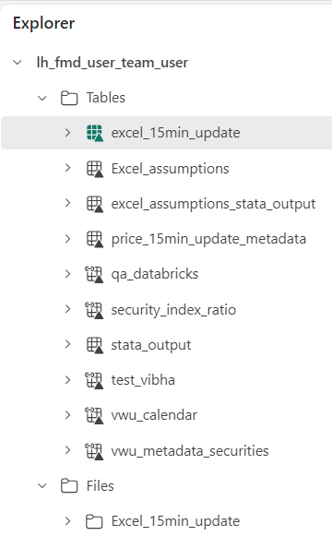


Governance : Same data, controlled access
Triton Environment
Dedicated Fabric workspace for Triton developers
Gold Lakehouse(s)
FMD
MTRS – Selected Users
Restricted Access - FMD only
Team Workspace
Full Access – FMD + MTRS
User Lakehouse
+ BYOD

Slide 18
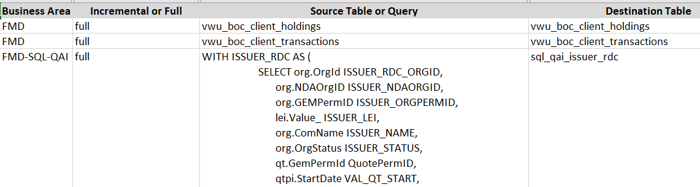
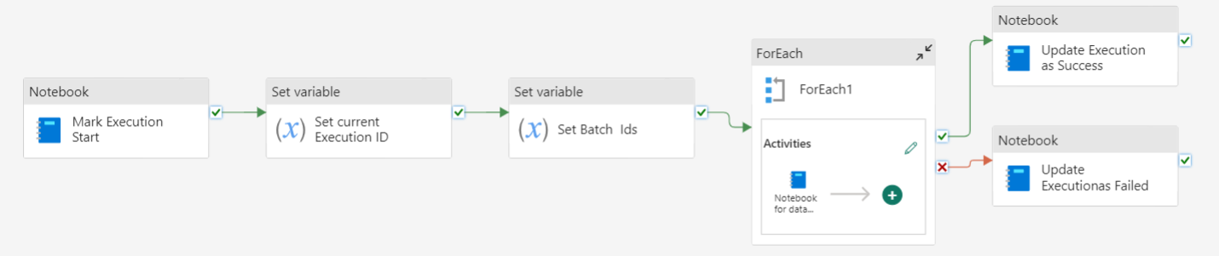




Data Ingestion : Reusable Pipeline Templates
1
Get configurations for data movement
Move Data
2
3
Save status and other run time stats
4
Monitor and Report

Slide 19
Fabric Triton environment - Findings
Efficiency
Ease of Use
Ease of Development
  Faster data movement
  -Dataflow Gen2 more performant than Gen1
  -Notebooks are more performant and scalable than Gen2 dataflows
  OneLake: Supports multiple data formats and sources when ingesting data.
  One Copy : Shortcuts avoids copying data across workspaces
  Governance: Lakehouse and shortcuts simplifies the management of permissions
Unified Interface for data engineering, data integration, and data science capabilities in a single workspace.
Scheduling and monitoring of processes is easy to set-up and flexible
  Allows for time schedule and event base triggers
  High frequency updates is possible
  Low-Code & Familiarity: Fabric integrates with Power BI, offers drag-and-drop options, and supports SQL/PySpark, making it easy to onboard and use alongside existing skill sets.
  Parameterization: Pipelines can be parameterized (for scalability and incremental loads) and scheduled easily
  Templates are easy to build, copy and share. Notebooks, semantic models, pipelines
  ETL Options:
  Pipelines | Notebooks | DataFlows

Slide 20


Building a comprehensive user workflow in Fabric
Onelake File Explorer
User environment
(Dedicated Fabric workspace for team)
v
Monitor
Monitoring Lakehouse
Notebook
15 min refresh
Prices updated every 15 minutes
PBI report via Direct Lake
24h refresh
User Lakehouse
Assumptions entered manually in excel
Notebook
Notebook
Team App
Stata model output
On-prem Stata Code reading Fabric or Databricks via ODBC
Databricks managed tables
Notes:
For the PoC, we wanted to test a true user workflow. You can think of what I am about to show as one of the most difficult use case we have in FMD, excluding ML applications which are experimental at this point. This complexity is not so much in term of computing power, but rather in terms of the flexibility and the number of steps involved.
Here what I want to do. I need to combined and transform data from various sources and publish them in a nice power bi report that will be shared via my team App. The data sources needed come from: an external statistical software called stata, an excel file that contains assumption manually entered by an economist, a feed of prices on government of Canada securities that need to be updated every 15 minutes, and Triton governed data. The workflow relies on non-standard data sources, such as Excel, and we will leverage Onelake file explorer to manage the data movement from excel to Fabric. Let’s go from start the beginning.
I have a stata script and need to read triton data from databricks or the triton lake house. The stata output ultimately need to be combined with some excel assumptions manually entered by the users. Let’s see how that works.

Slide 21
User workflow – Key findings
Data is truly centralized from the perspective of the users
  1 Lakehouse can contain Triton managed dataset, data ingested by the user, and model output
  Onelake explorer makes it easy to bring any type of data on demand, notably from Excel
Scheduling and orchestration is intuitive and flexible
  Users can build and monitor their own workflows with minimal support
Going from data to dashboard is streamlined significantly
  BI semantic models (source of BI reports) and reports (feeding dashboards) can be built, changed and version controlled efficiently 100% online in Power BI services.
  Refreshes of BI reports and alerts are easy to manage thanks to pipelines
  Visualization inside notebooks is more flexible than Databricks
Analytics is streamlined and performant
  Compute ready in a couple of seconds
  Performance was found to be identical to Databricks for key Triton models
  Lakehouses, Notebooks, Semantic models, BI reports are well integrated
  Key statistical packages are available inside notebooks

Slide 22
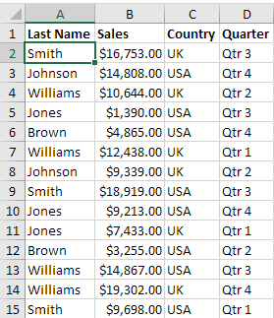


Alerts and monitoring of processes
Triton Managed
Data Sources
Triton Environment
Dedicated Fabric workspace for Triton developers
…
Monitor
30 user-facing tables in Databricks
Table 1 monitoring
Monitoring Lakehouse
Gold Lakehouse
Gold Lakehouse monitoring
On-prem SQL database (QaD)
Team 1 Workspace
User Lakehouse 1
+ BYOD
Monitoring Lakehouse
Notes:
2 main working platforms (for both Triton and Users) –each has own purpose and purposely built
Each has solutions to allow for Safeguarding of work, Collaboration and Sharing.
Pre-built solutions to accelerate work
Access to Triton Data
+ central info hub & streamlined navigation

Slide 23
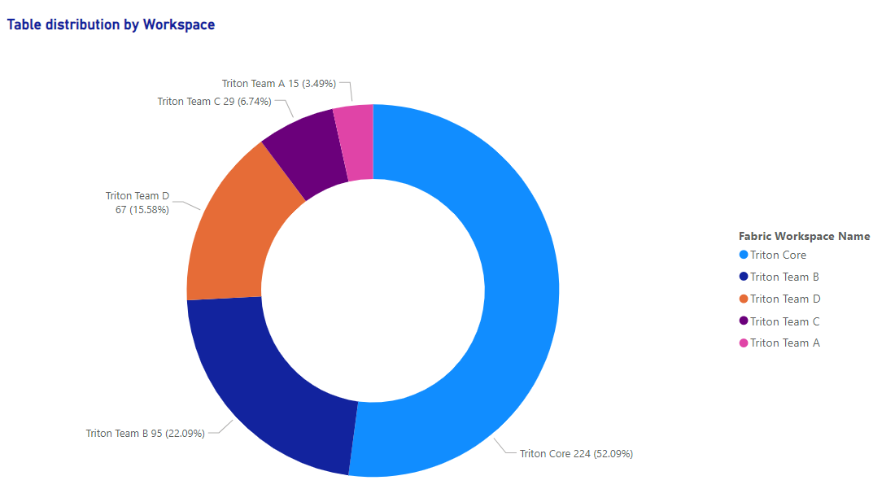
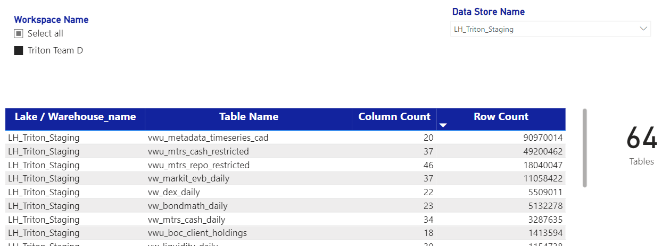
Data Profiling : Across Triton Workspaces
Run periodic scans across workspaces
Gather metadata and create Data Profile
Execute custom rules for Data Quality
Notes:
True also for

Slide 24
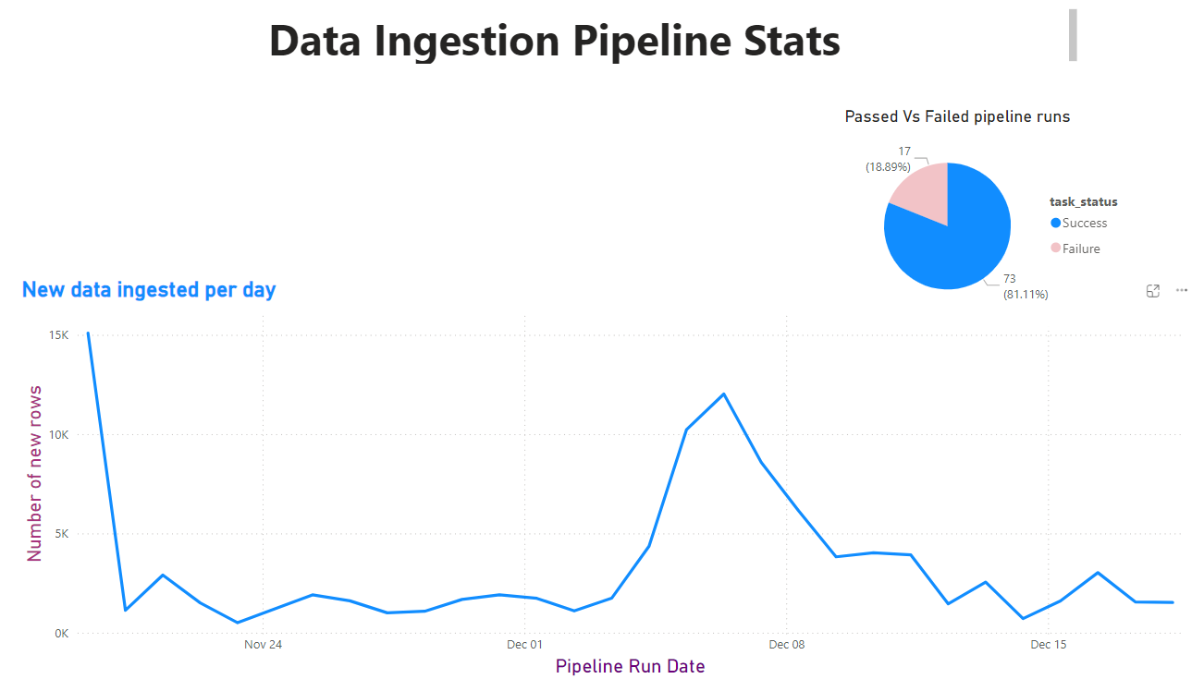
Monitor Data Pipelines
Monitor data velocity and volume growth.
Pipeline success rate
Find outliers

Slide 25
Alerts and monitoring of processes– Key findings
Monitoring of workspace content and activity is easy to set-up, scalable and efficient
  Lakehouse content and key statistics
  Table level data quality
  Overall content of workspace
Alerts are integrated with multiple Fabric components
  Data related events in a report
  Notebook and pipeline failures
  Completion of refreshes

Slide 26
PoC Summary

Slide 27
PoC highlights – End User Experience
Fabric as tested alleviates most end user frictions experienced in our current environments
  Significant business value across all 8 requirements
Fabric provides novel capabilities that further encourage users to work collaboratively and sustainably in the Cloud
  Egs include More templating, low code development, highly scalable and flexible monitoring
Fabric can allow for dynamic data extraction (eg LSEG QAD) and better Excel and Tool connectivity reducing need for Governed pipelines with no attached SLA (user supported processes can remain in hands of users)

Slide 28
PoC highlights – Support Perspective
Fabric dramatically streamlines and simplifies the setup and processes of supporting users
  Simpler and more automated user onboarding and streamlined data access controls
  Enhanced monitoring capabilities of users’ activities
  Far less duplication of data and redundant data movements required to enable users (increased resilience and robustness)
  Scalable and flexible monitoring of each element in our own value chains
  Potential for highly streamlined user environment to support

Slide 29
Conclusions & Implications
FMD use cases that cannot be accomplished in the Cloud today, can be developed completely in the Fabric Cloud environment using collaborative and sustainable practices
Detail oriented PoC shows Fabric as tested brings great value to both end user and supporting organizations – beyond original expectations
  Our PoC is aligned with current development efforts in IDAS, and show that the bulk of value (support and end user) is delivered through a full Fabric architecture
Fabric potentially enables a dramatically streamlined set of environments to support (Databricks Governed Data (slimmer) and Fabric for most user development) with better governance and monitoring of our and end user environments
Fabric is evolving rapidly some capacity draw to track evolution

Slide 30
Conclusions and Implications
Investment required to define a clear roadmap of Cloud User Enablement
  Eg What use cases belong in Fabric vs AC, if Fabric out of the box solves for many challenges we still face in AC, where does future development effort make the most sense
  Streamlining now seems ideal as more data and use cases moving to Cloud over next 3 years
Residual Topics
  Data management options (OneLake Catalogue vs Purview vs others)
  Environments and Dev Ops Practices – will Fabric remain only in Prod
  Supporting Org
  Desired SLA, investment to get there
  …

